Slide 1
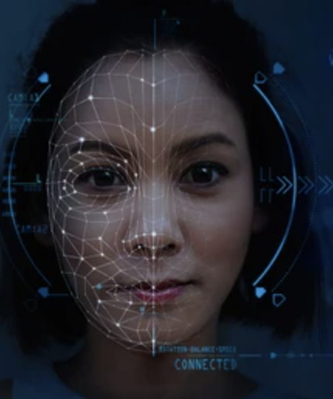
Deep Learning Capstone Project
Facial Emotional Recognition
By Nasif Khan

Slide 2
Problem: Using CNN’s to identify Facial Emotions
Context: Computer Vision plays an important role in a variety of applications, including detecting traffic objects, autonomous vehicle algorithms, and facial recognition. Using Convolutional Neural Networks to identify Facial Emotions is important due to its involvement with facial recognition security (such as unlocking an iPhone with facial recognition)
Objective: The objective behind this project is to use CNN’s to identify Facial Emotions through a variety of techniques including comparing & compiling two Convolutional Neural Network models, fitting and evaluating these models, and reporting the findings between the training, testing and validation datasets.
Key Questions: Some questions we will follow up on include: What are other techniques that can be implemented for greater accuracy? What are some identifying elements in the 4 data classes? What are the key measures of success for these techniques? What is the potential solution design?
Problem Formulation: We are trying to build a CNN model that accurately predicts facial emotions with close to 99% confidence.

Slide 3
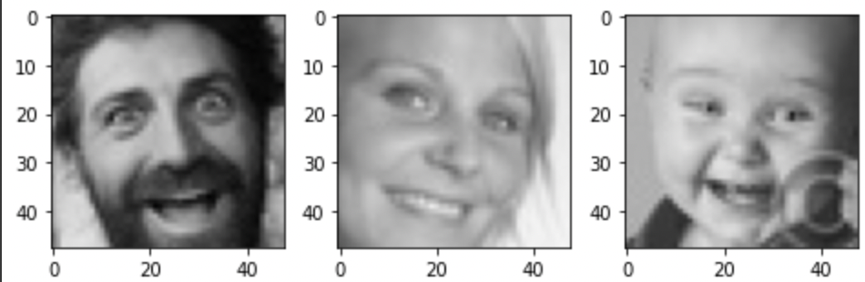
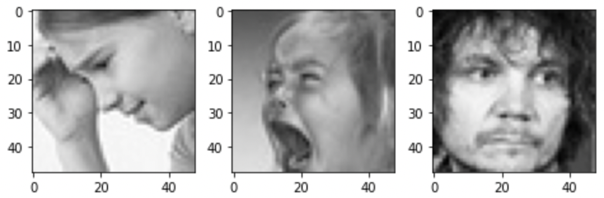
Data Exploration
This dataset contains 3 folders (test, train, validation), with each folder containing 4 subfolders which include:
‘happy’: dataset including images of people with happy expressions (3,976 images)
‘sad’: dataset including images of people with sad expressions (3,982 images)
‘neutral’: dataset including images of people with neutral expressions (3,978 images)
‘surprise’: dataset including images of people with surprised expressions (3,173 images)
*see below for example on ‘happy’ dataset (left) compared to ‘sad’ dataset (right)

Slide 4
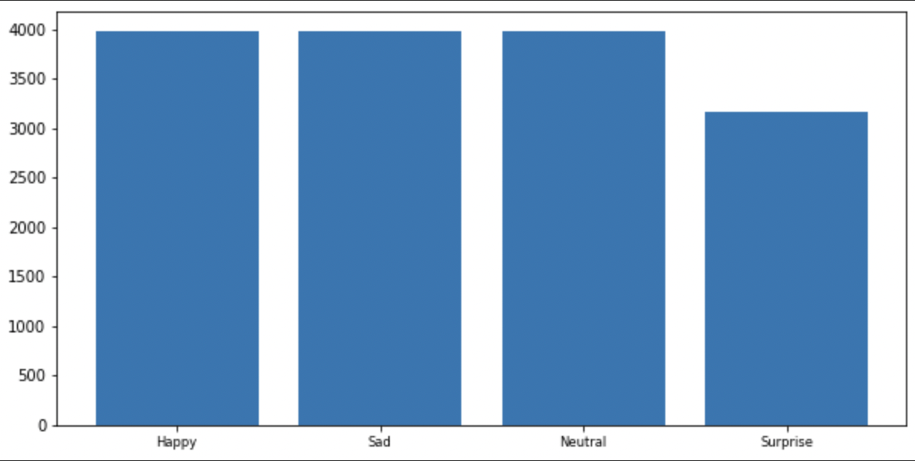
Data Exploration (cont.)
We can observe patterns with the four sub-categories (happy, sad, neutral, surprise) including the contour of someone’s lips when they are either smiling or upset. Neutral expressions tend to have the same, linear contour of their lips. These are a few examples of some patterns we can observe in the data visually.
We can also observe a roughly even distribution image count within all 4 sub-categories. The distribution below visualizes the count for each expression, although the surprised expression has a comparably smaller count. This may lead to underfitting when evaluating our model.

Slide 5
Data Exploration (cont.)
This dataset is already aptly split into train, test and validation sets. However, we will write some pre-processing code to create the image generated training, testing, and validation splits.

Slide 6
Proposed Approach
Our proposed approach is simple. After completing some prior exploratory data analysis, visualization, and distribution checks; we will begin by creating data loaders which will serve as inputs for our neural network. The data loaders will be set to the testing and validation sets.
We will then create our neural network base: which will include three convolutional blocks, each containing a Conv2D layer, Maxpooling layer, and a Dropout layer. Each block will have a variety of filters, kernels, and neurons (for the dense layer).
Compile, Train, & Optimize base network model
Fit & Evaluate Model over training and testing datasets
Repeat the steps above for a second neural network base model & compare results/ model performance

